Slide 1
Final Structures
EB

Slide 2
Solvent

Slide 3
HF
CHANGE IN ENERGY = -10.8342054034

Slide 4
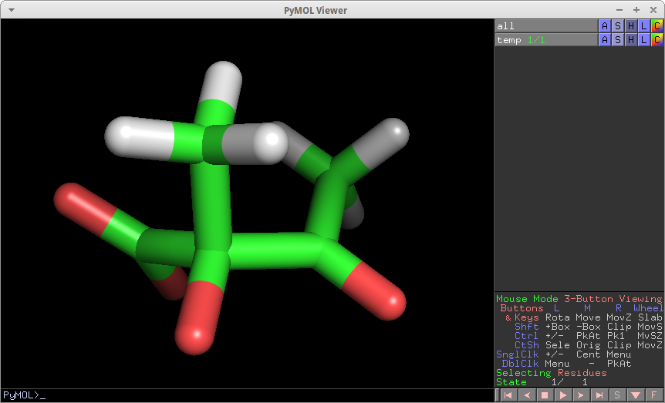
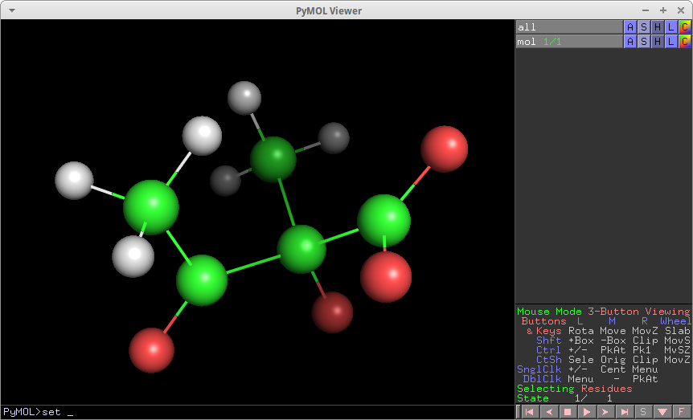
Reactant
Final energy is -308867.40124
Notes:
ATOM 1 C RES 1 1.188 0.276 0.387 C
ATOM 2 O RES 1 0.950 0.971 1.397 O
ATOM 3 O RES 1 2.251 0.269 -0.260 O
ATOM 4 C RES 1 0.018 -0.670 -0.090 C
ATOM 5 C RES 1 0.056 -0.798 -1.654 C
ATOM 6 O RES 1 0.059 -1.873 0.471 O
ATOM 7 C RES 1 -1.303 0.112 0.181 C
ATOM 8 O RES 1 -2.304 -0.354 0.661 O
ATOM 9 C RES 1 -1.395 1.573 -0.288 C
ATOM 10 H RES 1 -2.218 1.655 -0.999 H
ATOM 11 H RES 1 -0.486 1.944 -0.738 H
ATOM 12 H RES 1 -1.624 2.187 0.575 H
ATOM 13 H RES 1 -0.777 -1.426 -1.969 H
ATOM 14 H RES 1 0.986 -1.294 -1.901 H
ATOM 15 H RES 1 0.021 0.145 -2.205 H

Slide 5
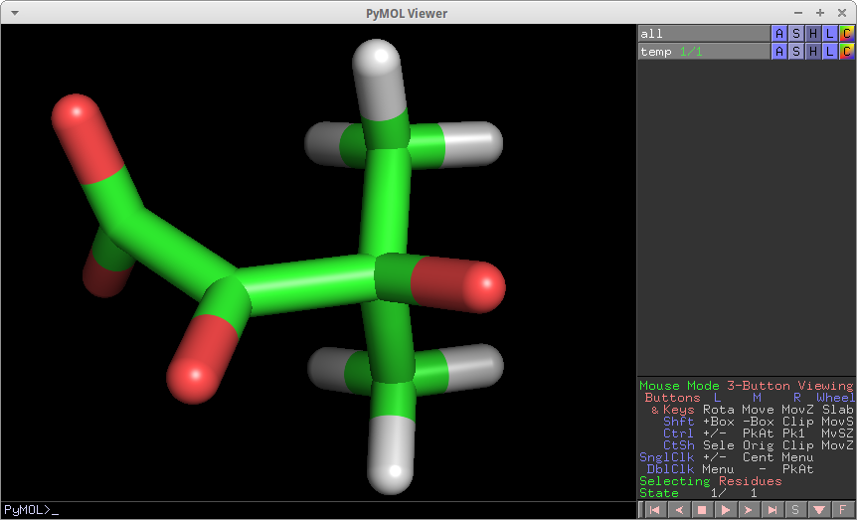
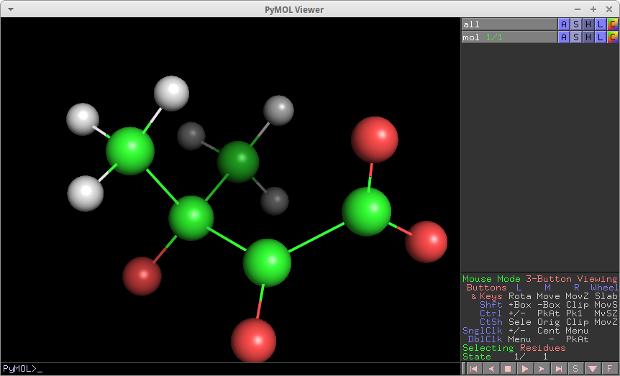
Product
Final energy is -308878.235446
Notes:
ATOM 1 C RES 1 1.479 0.167 -0.384 C
ATOM 2 O RES 1 1.824 1.283 0.035 O
ATOM 3 O RES 1 1.965 -0.488 -1.314 O
ATOM 4 C RES 1 0.297 -0.488 0.371 C
ATOM 5 C RES 1 -1.246 0.450 -1.413 C
ATOM 6 O RES 1 0.560 -1.270 1.250 O
ATOM 7 C RES 1 -1.188 -0.080 0.047 C
ATOM 8 O RES 1 -2.073 -1.057 0.239 O
ATOM 9 C RES 1 -1.459 1.130 0.998 C
ATOM 10 H RES 1 -2.466 1.497 0.791 H
ATOM 11 H RES 1 -0.746 1.946 0.887 H
ATOM 12 H RES 1 -1.435 0.776 2.025 H
ATOM 13 H RES 1 -1.021 -0.358 -2.103 H
ATOM 14 H RES 1 -0.566 1.276 -1.618 H
ATOM 15 H RES 1 -2.268 0.779 -1.600 H

Slide 6
*B3LYP
CHANGE IN ENERGY = -10.5225548156

Slide 7
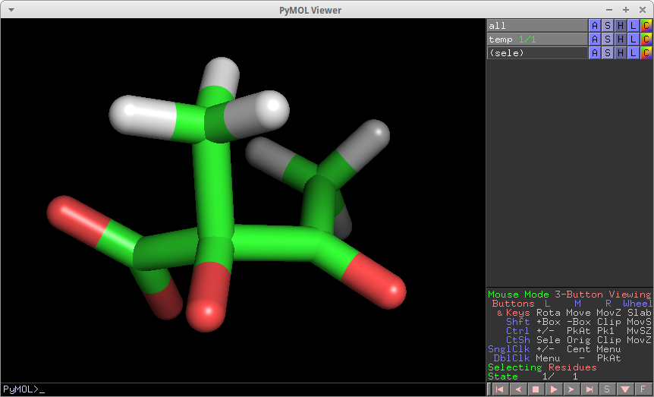
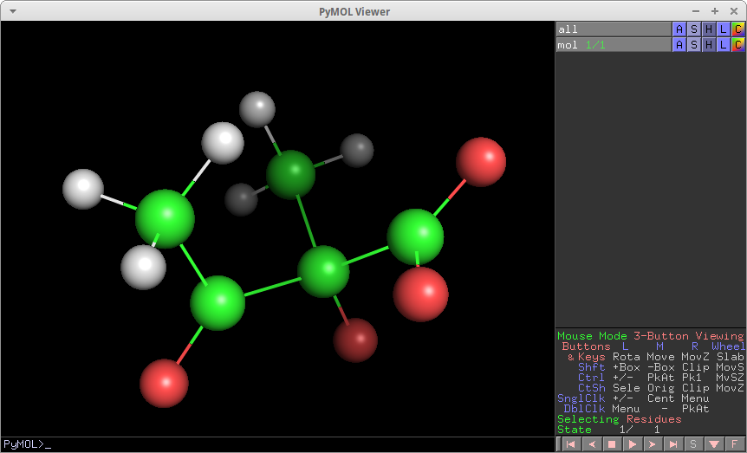
Reactant
Final energy is -310639.854789
Notes:
ATOM 1 C RES 1 1.355 0.243 0.054 C
ATOM 2 O RES 1 2.272 0.275 -0.817 O
ATOM 3 O RES 1 1.349 0.869 1.161 O
ATOM 4 C RES 1 0.080 -0.706 -0.225 C
ATOM 5 C RES 1 -0.233 -0.676 -1.787 C
ATOM 6 O RES 1 0.250 -1.961 0.194 O
ATOM 7 C RES 1 -1.149 0.042 0.397 C
ATOM 8 O RES 1 -2.005 -0.481 1.106 O
ATOM 9 C RES 1 -1.356 1.531 0.038 C
ATOM 10 H RES 1 -0.542 1.947 -0.559 H
ATOM 11 H RES 1 -1.428 2.100 0.973 H
ATOM 12 H RES 1 -2.309 1.632 -0.505 H
ATOM 13 H RES 1 -1.086 -1.345 -1.977 H
ATOM 14 H RES 1 0.664 -1.074 -2.271 H
ATOM 15 H RES 1 -0.440 0.321 -2.215 H

Slide 8
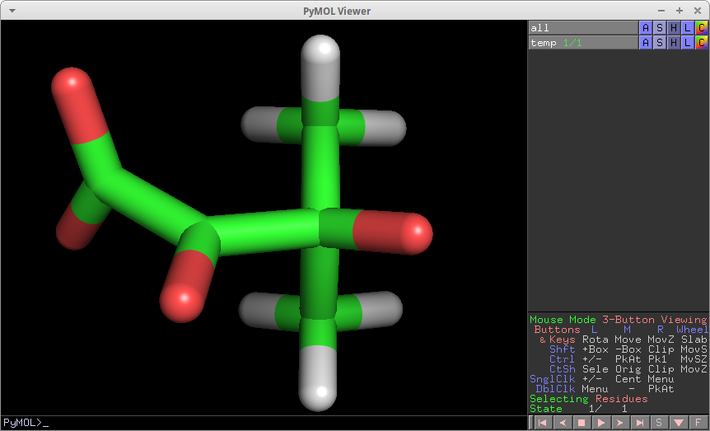
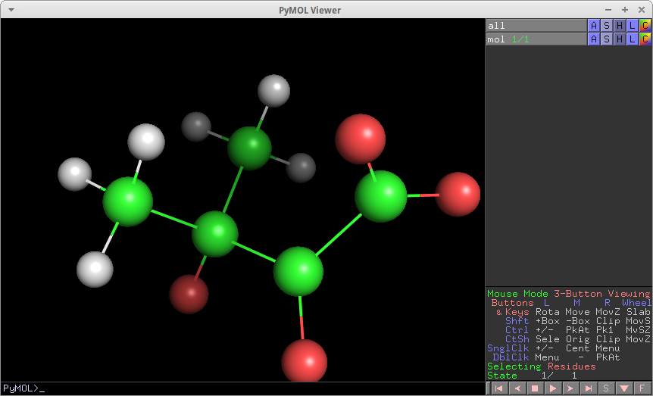
Product
Final energy is -310650.377344
Notes:
ATOM 1 C RES 1 1.493 0.181 -0.372 C
ATOM 2 O RES 1 1.850 1.309 0.078 O
ATOM 3 O RES 1 1.989 -0.465 -1.337 O
ATOM 4 C RES 1 0.307 -0.497 0.373 C
ATOM 5 C RES 1 -1.256 0.448 -1.424 C
ATOM 6 O RES 1 0.566 -1.315 1.254 O
ATOM 7 C RES 1 -1.205 -0.097 0.045 C
ATOM 8 O RES 1 -2.095 -1.079 0.249 O
ATOM 9 C RES 1 -1.463 1.139 0.999 C
ATOM 10 H RES 1 -2.483 1.502 0.793 H
ATOM 11 H RES 1 -0.739 1.957 0.871 H
ATOM 12 H RES 1 -1.427 0.784 2.038 H
ATOM 13 H RES 1 -1.058 -0.374 -2.122 H
ATOM 14 H RES 1 -0.541 1.259 -1.628 H
ATOM 15 H RES 1 -2.280 0.812 -1.602 H

Slide 9
No Solvent

Slide 10
HF
CHANGE IN ENERGY = -10.8457520082

Slide 11
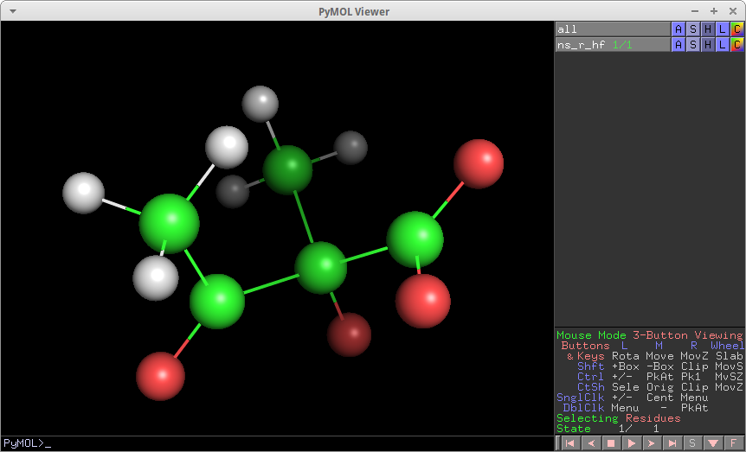
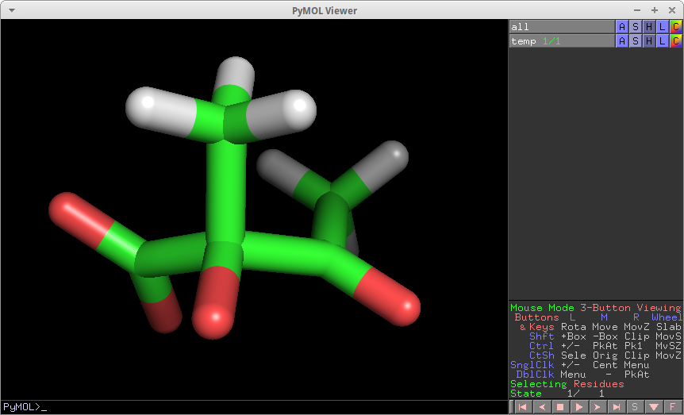
Reactant
Final energy is -308845.531157
Notes:
ATOM 1 C RES 1 1.188 0.276 0.387 C
ATOM 2 O RES 1 0.950 0.972 1.396 O
ATOM 3 O RES 1 2.251 0.267 -0.259 O
ATOM 4 C RES 1 0.018 -0.670 -0.090 C
ATOM 5 C RES 1 0.056 -0.798 -1.654 C
ATOM 6 O RES 1 0.059 -1.873 0.471 O
ATOM 7 C RES 1 -1.303 0.112 0.181 C
ATOM 8 O RES 1 -2.304 -0.353 0.662 O
ATOM 9 C RES 1 -1.395 1.573 -0.288 C
ATOM 10 H RES 1 -2.218 1.654 -1.000 H
ATOM 11 H RES 1 -0.486 1.944 -0.739 H
ATOM 12 H RES 1 -1.624 2.188 0.574 H
ATOM 13 H RES 1 -0.778 -1.426 -1.968 H
ATOM 14 H RES 1 0.985 -1.295 -1.900 H
ATOM 15 H RES 1 0.021 0.145 -2.205 H

Slide 12
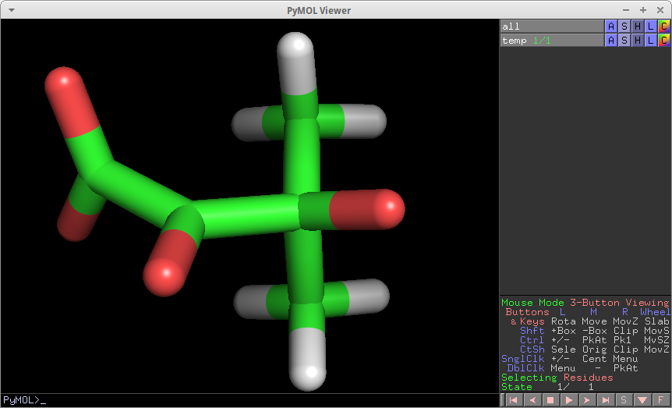
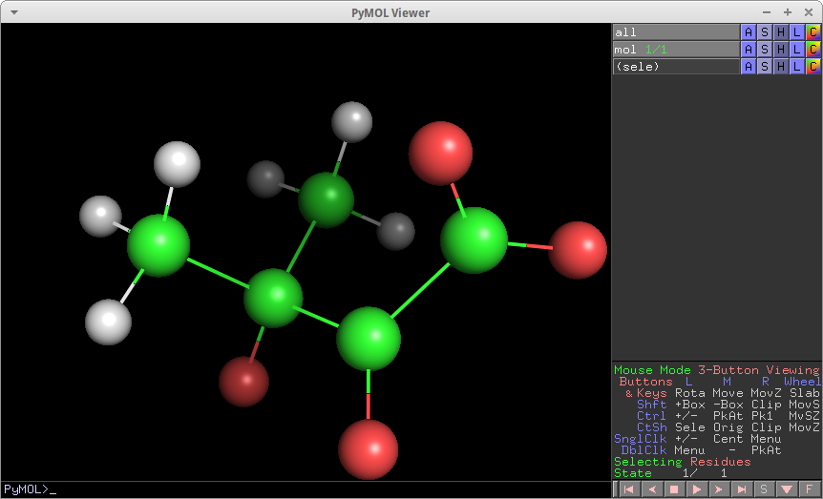
Product
Final energy is -308856.376909
Notes:
ATOM 1 C RES 1 1.479 0.167 -0.384 C
ATOM 2 O RES 1 1.825 1.283 0.034 O
ATOM 3 O RES 1 1.964 -0.489 -1.314 O
ATOM 4 C RES 1 0.297 -0.488 0.372 C
ATOM 5 C RES 1 -1.246 0.450 -1.413 C
ATOM 6 O RES 1 0.560 -1.269 1.251 O
ATOM 7 C RES 1 -1.188 -0.080 0.047 C
ATOM 8 O RES 1 -2.073 -1.058 0.239 O
ATOM 9 C RES 1 -1.459 1.130 0.998 C
ATOM 10 H RES 1 -2.466 1.497 0.791 H
ATOM 11 H RES 1 -0.746 1.946 0.887 H
ATOM 12 H RES 1 -1.435 0.775 2.025 H
ATOM 13 H RES 1 -1.021 -0.357 -2.103 H
ATOM 14 H RES 1 -0.566 1.277 -1.618 H
ATOM 15 H RES 1 -2.268 0.779 -1.600 H

Slide 13
*B3LYP
CHANGE IN ENERGY = -10.5301372264

Slide 14
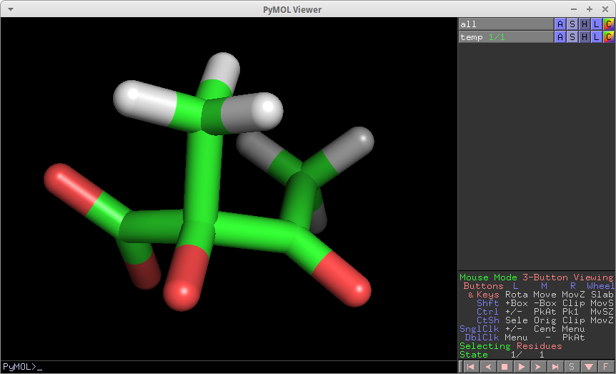
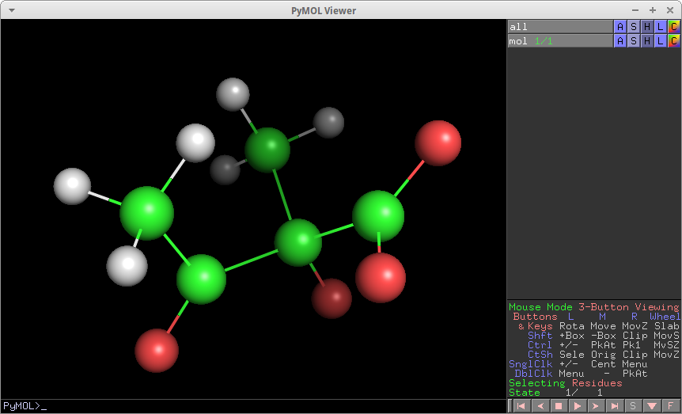
Reactant
Final energy is -310617.990001
Notes:
ATOM 1 C RES 1 1.355 0.248 0.053 C
ATOM 2 O RES 1 2.271 0.282 -0.818 O
ATOM 3 O RES 1 1.348 0.874 1.160 O
ATOM 4 C RES 1 0.081 -0.705 -0.225 C
ATOM 5 C RES 1 -0.232 -0.679 -1.787 C
ATOM 6 O RES 1 0.255 -1.959 0.197 O
ATOM 7 C RES 1 -1.149 0.040 0.396 C
ATOM 8 O RES 1 -2.006 -0.483 1.103 O
ATOM 9 C RES 1 -1.357 1.530 0.039 C
ATOM 10 H RES 1 -0.548 1.945 -0.566 H
ATOM 11 H RES 1 -1.419 2.099 0.974 H
ATOM 12 H RES 1 -2.316 1.633 -0.495 H
ATOM 13 H RES 1 -1.084 -1.350 -1.975 H
ATOM 14 H RES 1 0.665 -1.075 -2.271 H
ATOM 15 H RES 1 -0.442 0.317 -2.216 H

Slide 15
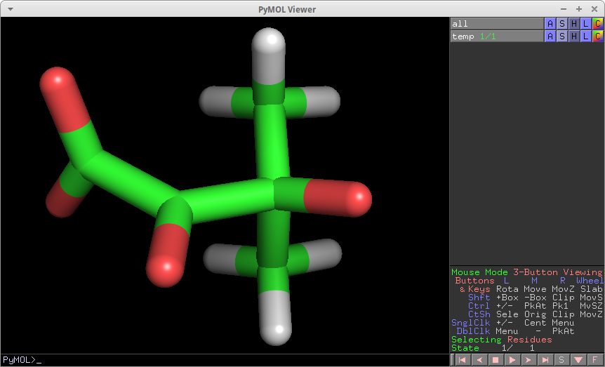
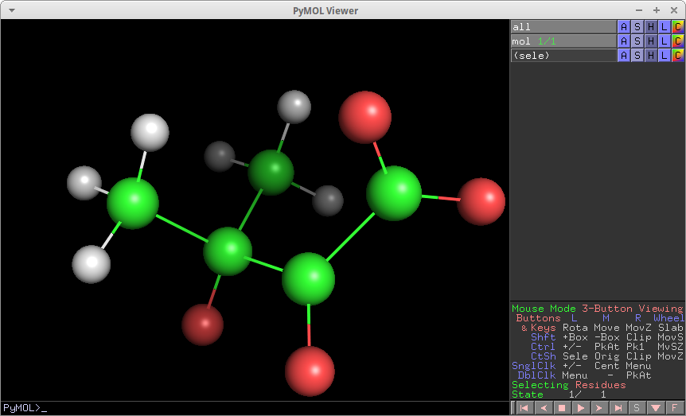
Product
Final energy is -310628.520138
Notes:
ATOM 1 C RES 1 1.493 0.180 -0.373 C
ATOM 2 O RES 1 1.851 1.309 0.076 O
ATOM 3 O RES 1 1.989 -0.467 -1.337 O
ATOM 4 C RES 1 0.307 -0.496 0.373 C
ATOM 5 C RES 1 -1.256 0.448 -1.424 C
ATOM 6 O RES 1 0.566 -1.313 1.255 O
ATOM 7 C RES 1 -1.204 -0.097 0.045 C
ATOM 8 O RES 1 -2.095 -1.080 0.248 O
ATOM 9 C RES 1 -1.464 1.139 1.000 C
ATOM 10 H RES 1 -2.484 1.501 0.794 H
ATOM 11 H RES 1 -0.739 1.957 0.871 H
ATOM 12 H RES 1 -1.428 0.784 2.038 H
ATOM 13 H RES 1 -1.058 -0.374 -2.123 H
ATOM 14 H RES 1 -0.541 1.260 -1.628 H
ATOM 15 H RES 1 -2.280 0.813 -1.602 H

Slide 16
FSM

Slide 17
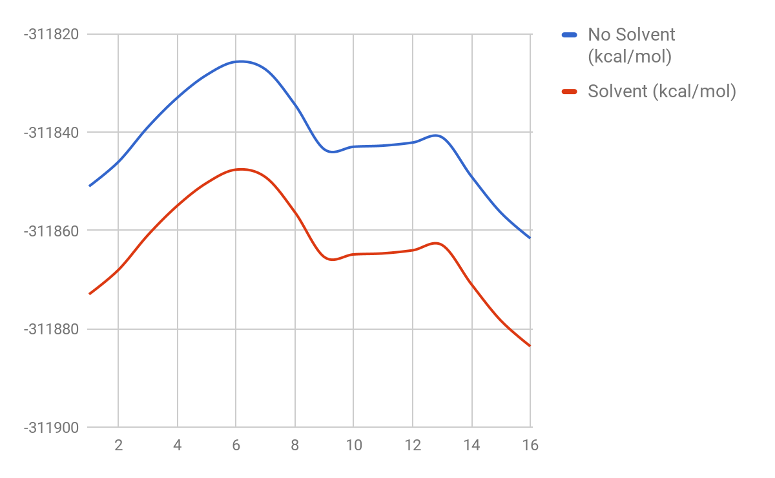
FSM Energy

Slide 18
Solvent

Slide 19
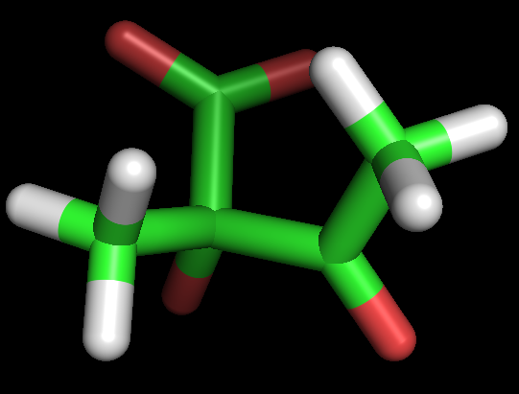
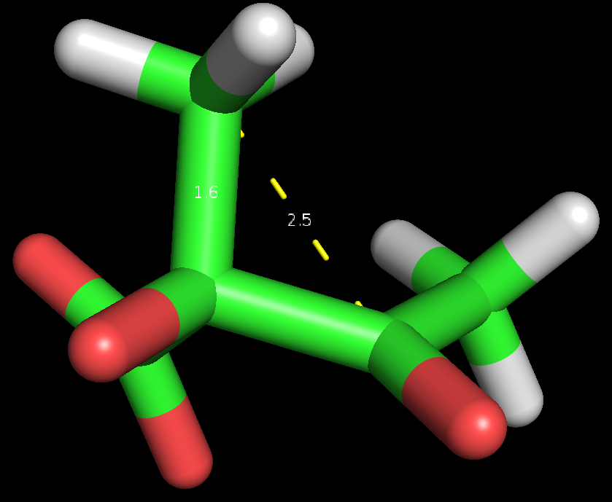

Slide 20
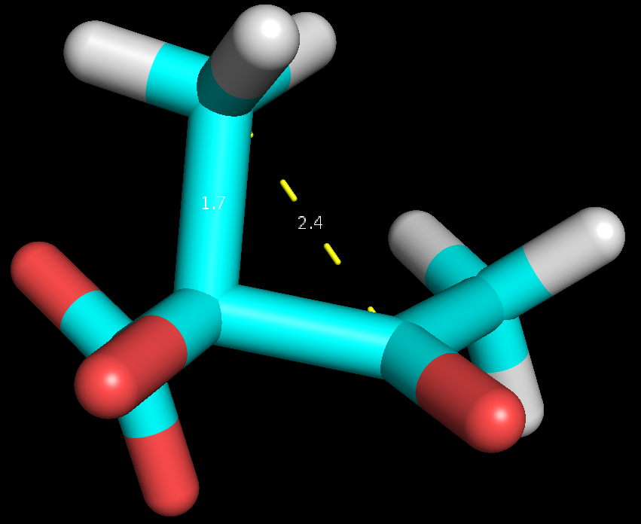
Notes:
2

Slide 21
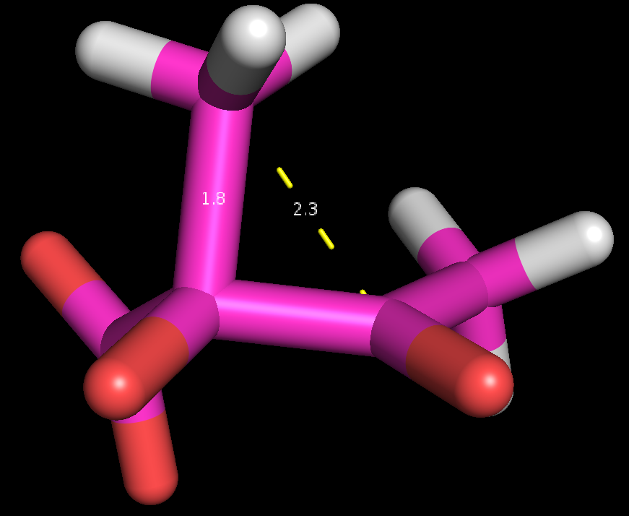
Notes:
3

Slide 22
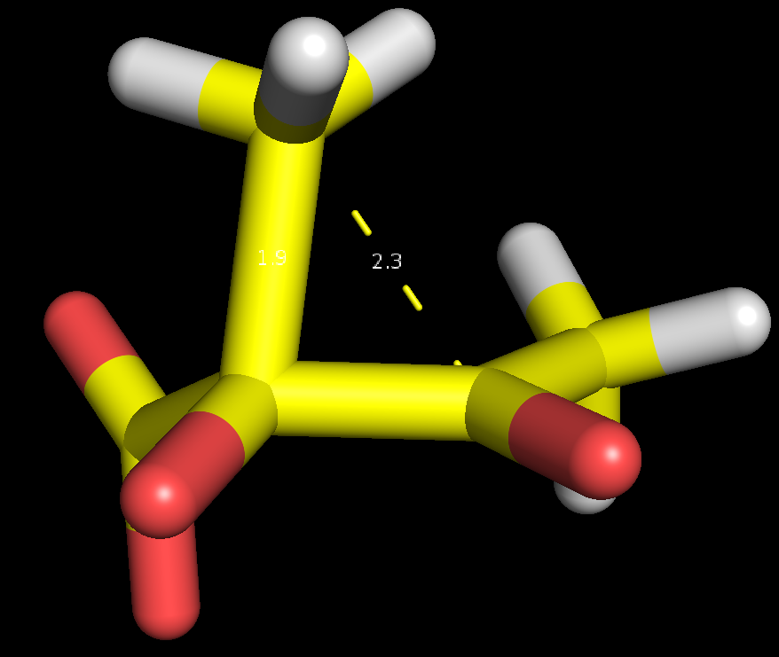
Notes:
4

Slide 23
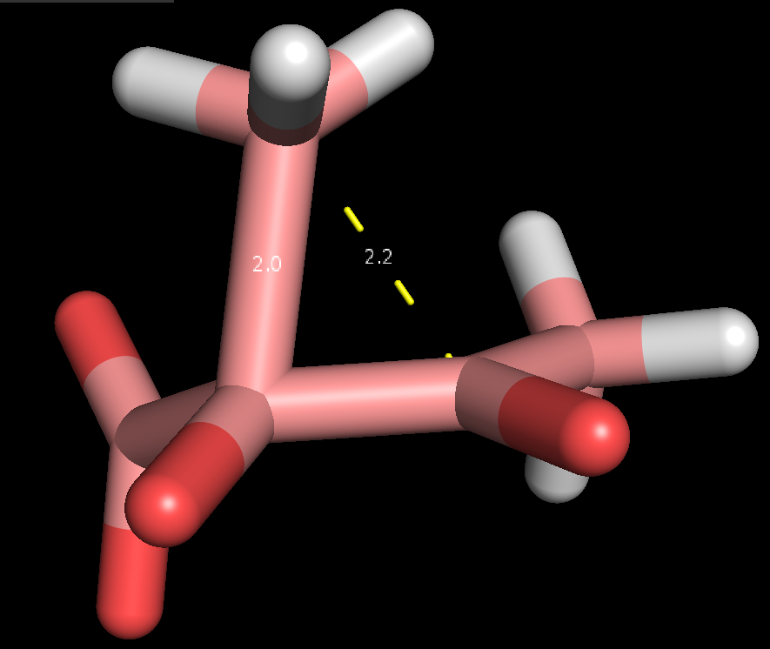
Notes:
5

Slide 24
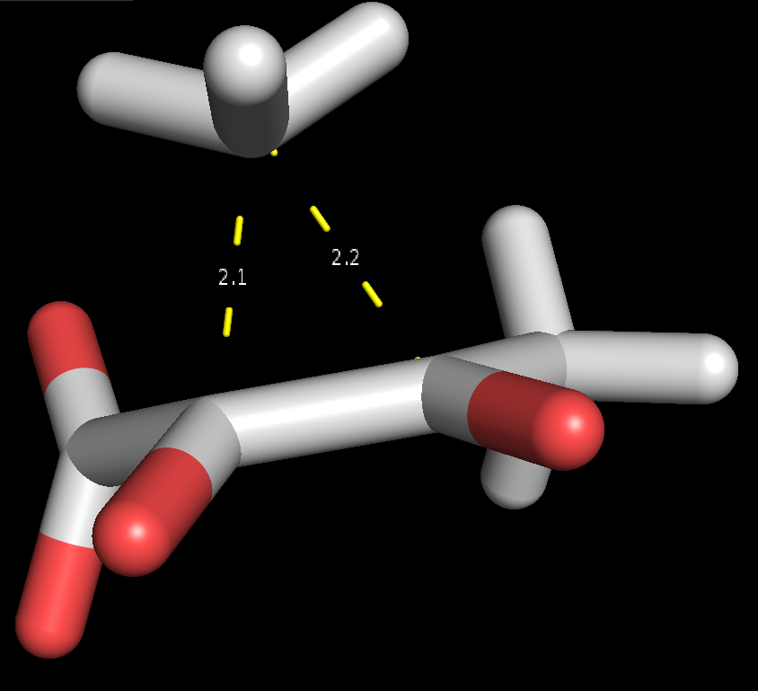
Notes:
6 - TS

Slide 25
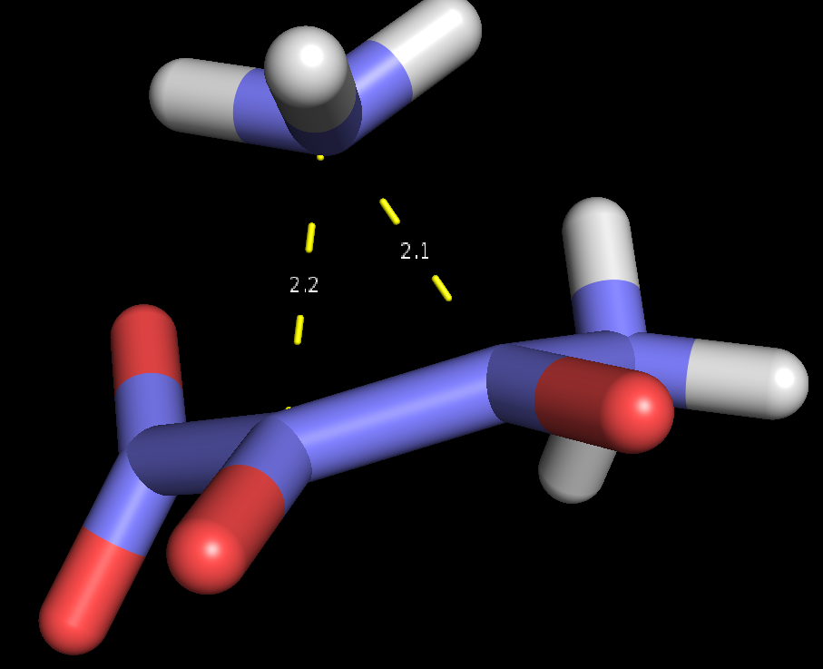
Notes:
7

Slide 26
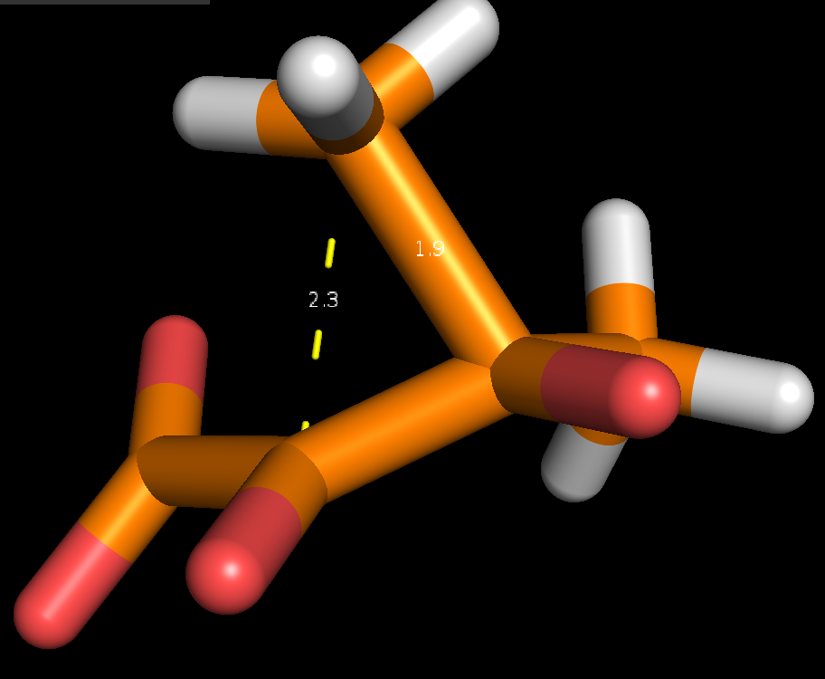
Notes:
8

Slide 27
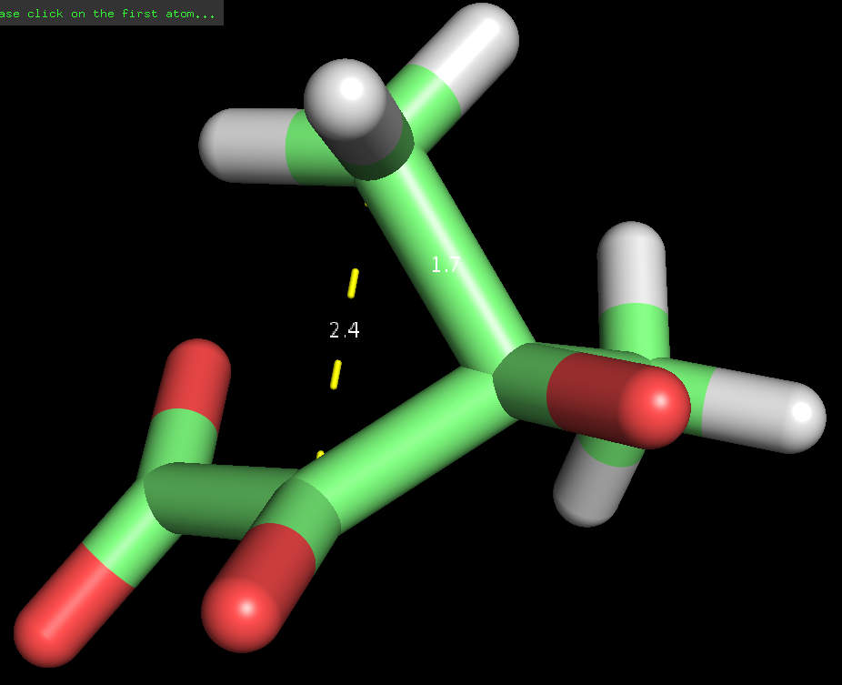
Notes:
9 - Energy plateau begins

Slide 28
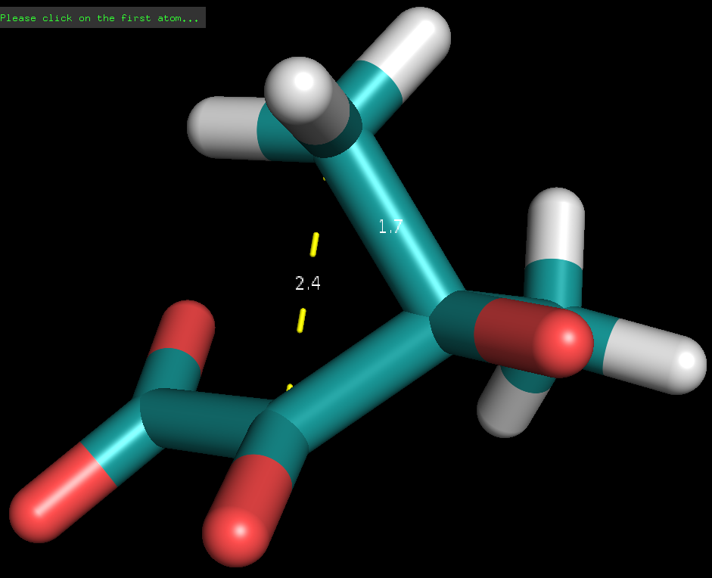
Notes:
10

Slide 29
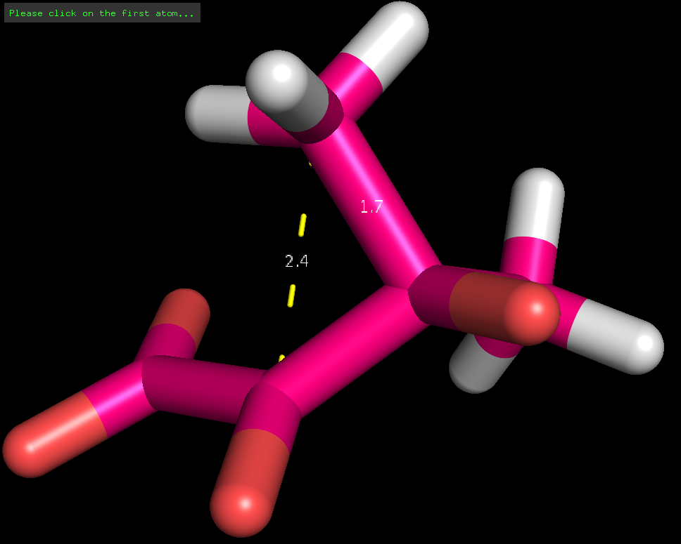
Notes:
11

Slide 30
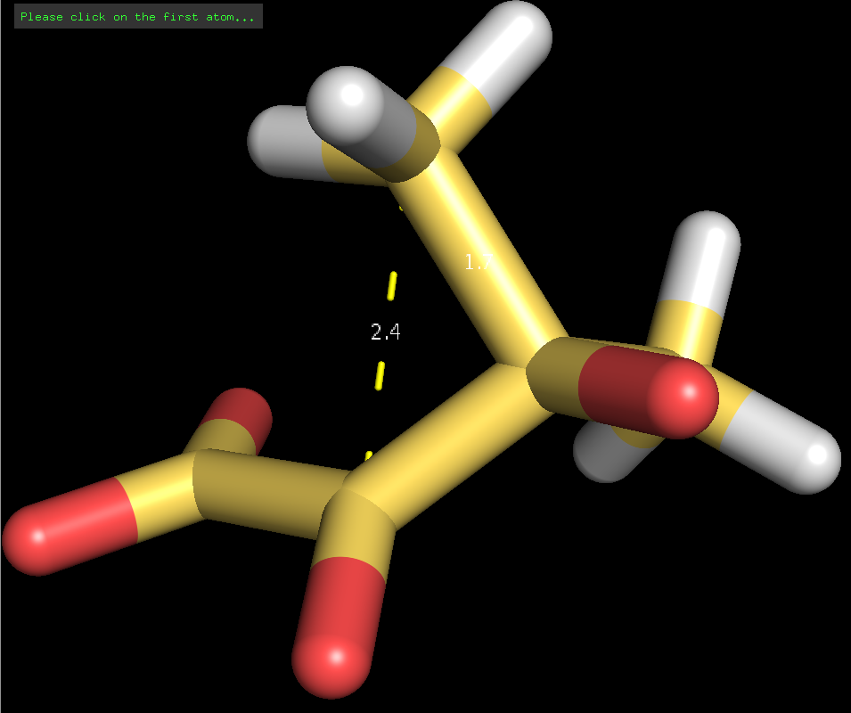
Notes:
12

Slide 31
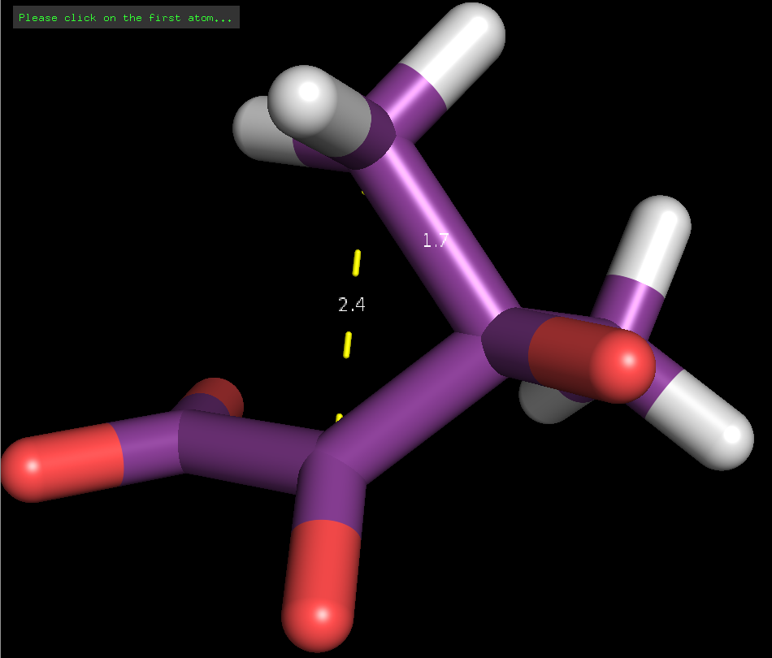
Notes:
13 - energy reaches local maximum

Slide 32
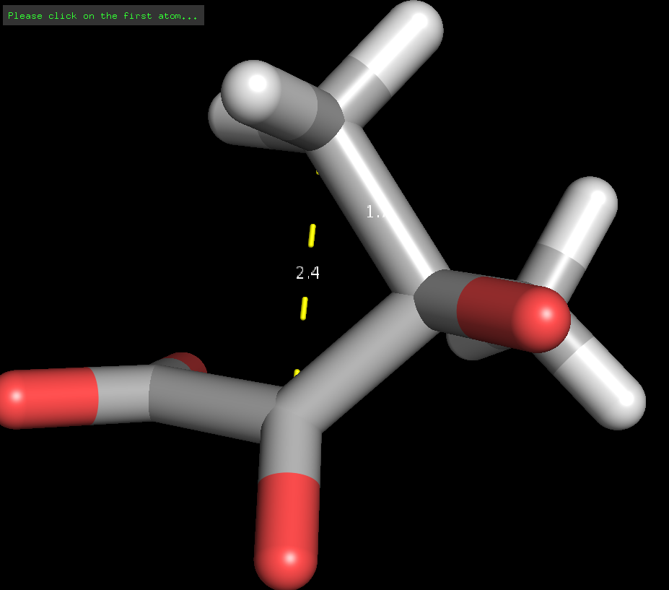
Notes:
14

Slide 33
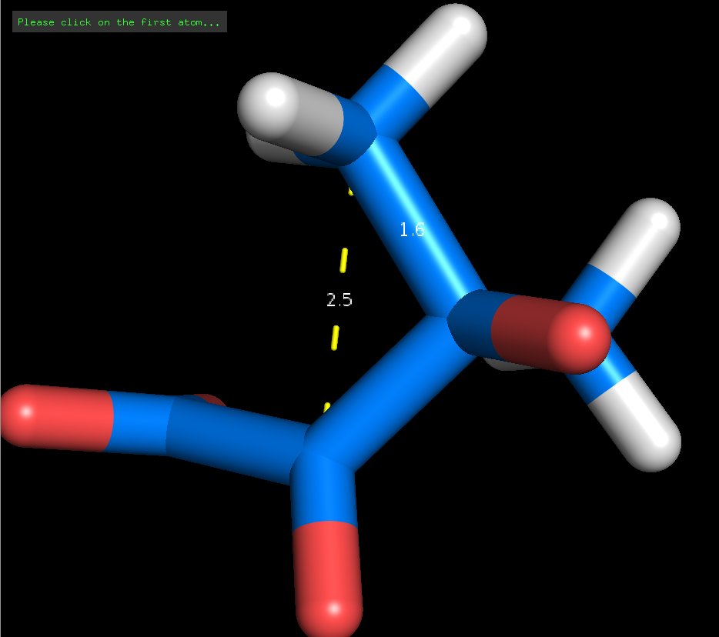
Notes:
15

Slide 34
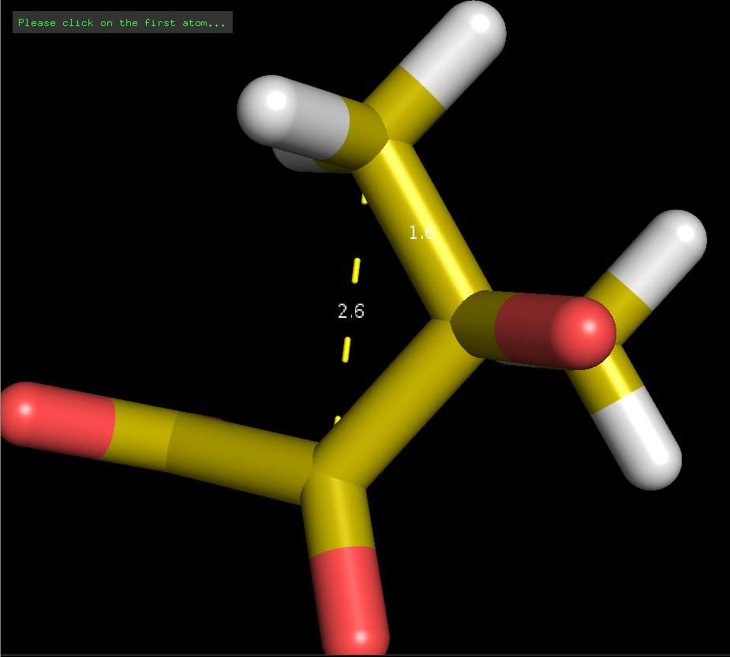
Notes:
16

Slide 35
No Solvent

Slide 36
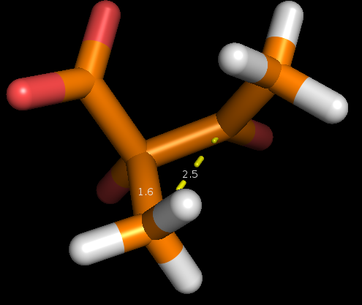
Notes:
1

Slide 37
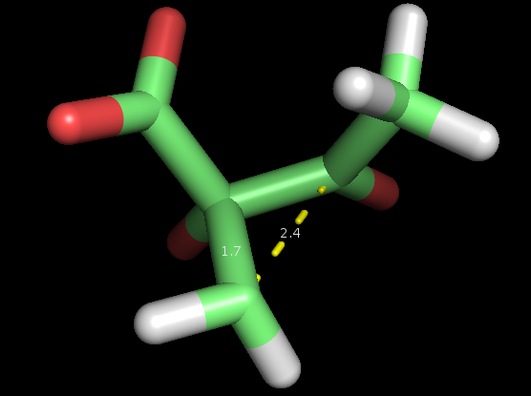
Notes:
2

Slide 38
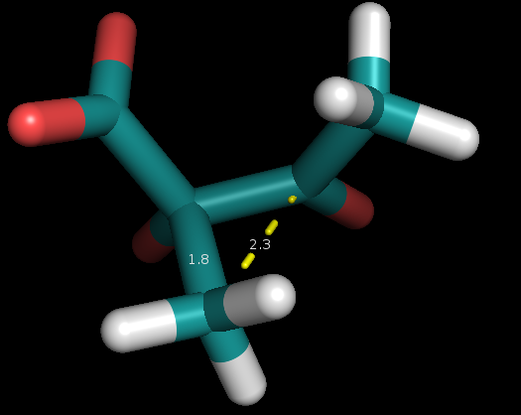
Notes:
3

Slide 39
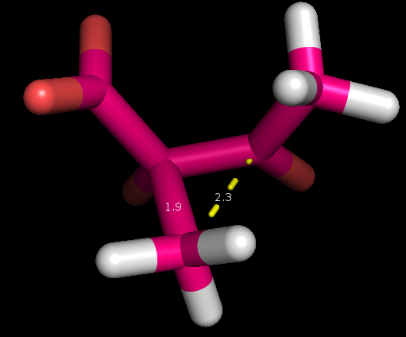
Notes:
4

Slide 40
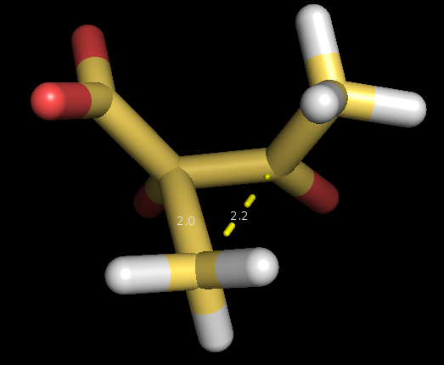
Notes:
5

Slide 41
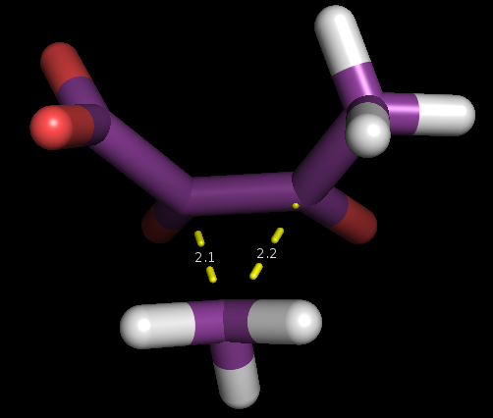
Notes:
6 - TS

Slide 42
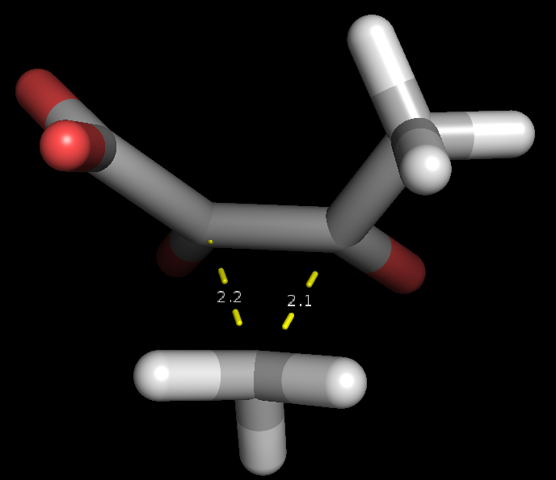
Notes:
7

Slide 43
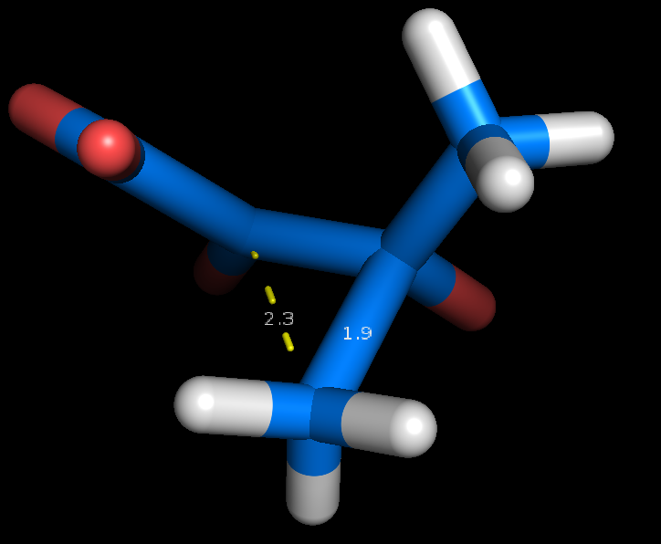
Notes:
8

Slide 44
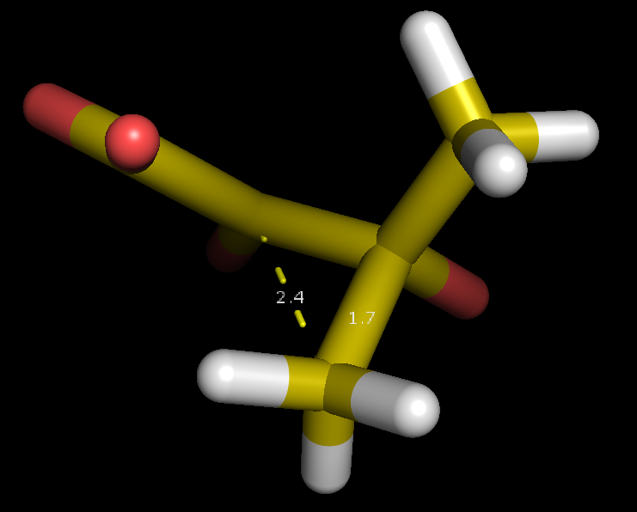
Notes:
9 - energy plateau begins

Slide 45
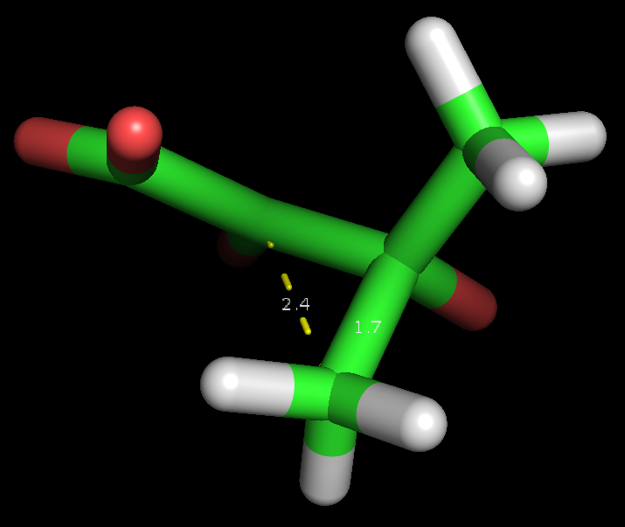
Notes:
10

Slide 46
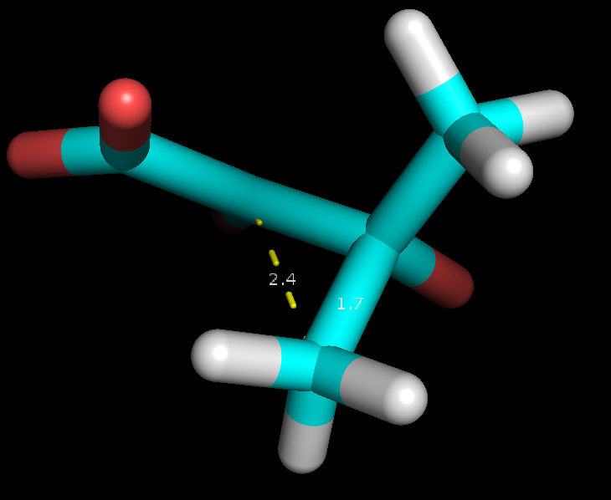
Notes:
11

Slide 47
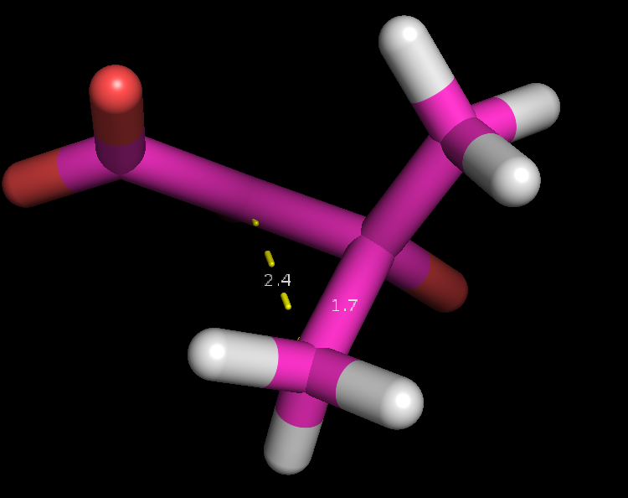
Notes:
12

Slide 48
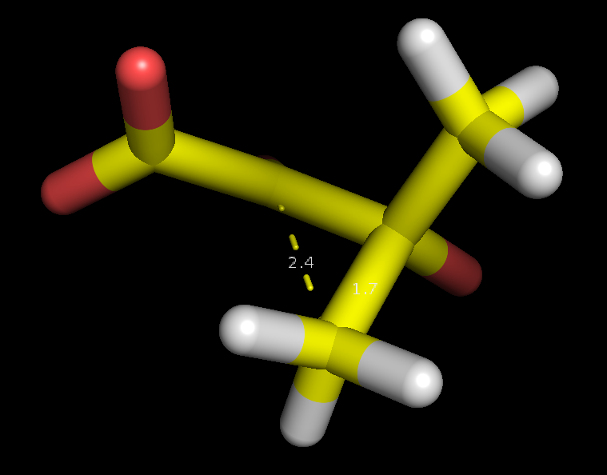
Notes:
13 - energy plateau ends

Slide 49
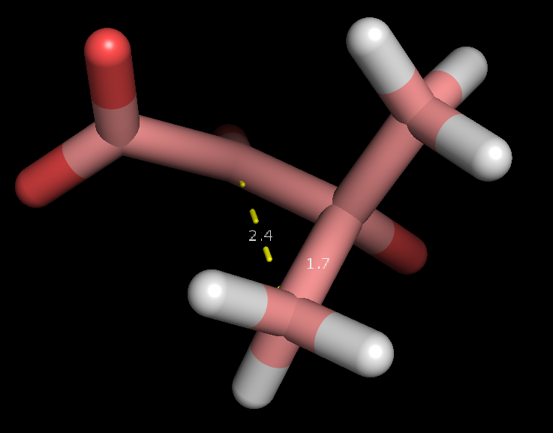
Notes:
14

Slide 50
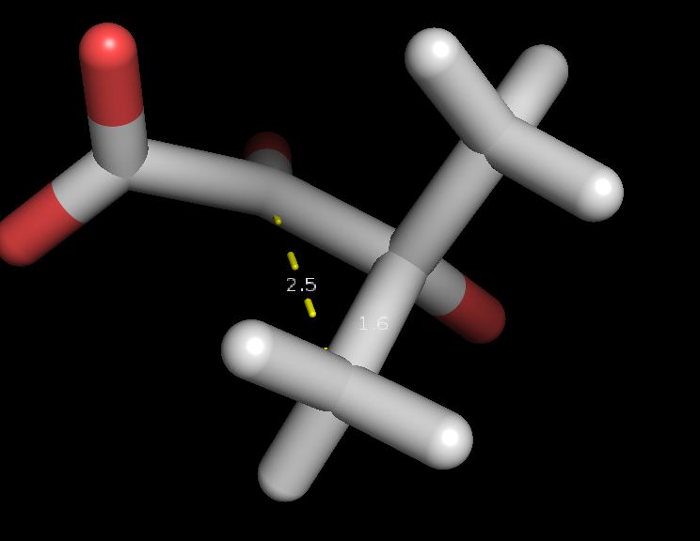
Notes:
15

Slide 51
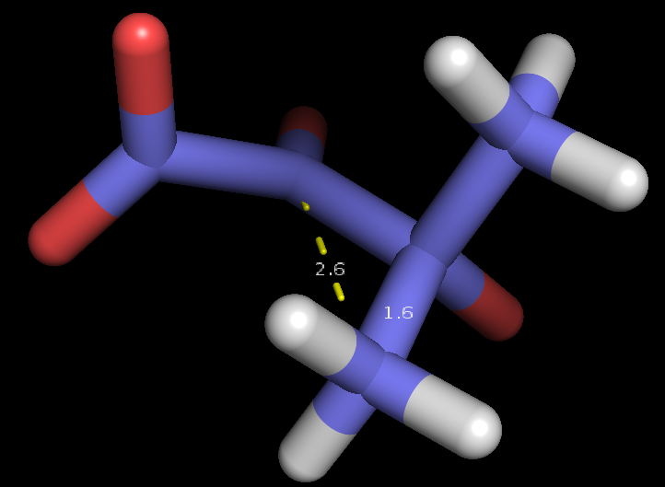
Notes:
16

Slide 52

Transition State
Notes:
From frame 1020, also saw convergence from frame 1030. Note that the distances are identical to those found in FSM identified transition states from solvent and no solvent.

Slide 53
Transition State
Solvent
No Solvent
Notes:
From frame 1020, also saw convergence from frame 1030. Note that the distances are identical to those found in FSM identified transition states from solvent and no solvent.
On left from TS, on right from FSM energies.

Slide 54


IRC
Reactant from IRC
Product

Slide 55
IRC
Reactant from IRC
Reactant from FSM with solvent

Slide 56
IRC
Product from IRC
Product from FSM with solvent

Slide 57
Partial Charges

Slide 58

IRC Reactant
Notes:
scale: -0.916 - 0.759

Slide 59

Reactant
Notes:
Red = most positive, Blue = most negative
scale: -0.916 - 0.754

Slide 60

Transition State
Notes:
-0.884 - 0.732

Slide 61

Product
Notes:
-0.953 - 0.699

Slide 62
Molecular Orbitals

Slide 63

IRC Reactant
Notes:
scale: -0.916 - 0.759

Slide 64

Reactant
Notes:
Red = most positive, Blue = most negative
scale: -0.916 - 0.754

Slide 65

Transition State
Notes:
-0.884 - 0.732

Slide 66

Product
Notes:
-0.953 - 0.699

